Slide 1
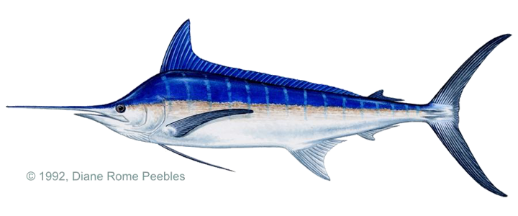
Great Catch!
Fishing Socially
Species Identification

Slide 2
Billfish Problem Set
Create a tool that can streamline the fisheries data collection process, and enable fishermen to play a role in data collection.
Create a tool that can enable non-experts to carry out fisheries data collection from measurement to statistic without human intervention and internet access.
Useful Data:
Different types of Fish Species Caught
Number of each fish species caught
Length of individual fish within a species
Timestamp and gps
Notes:
Scientists seek to track the fishing habits of small scale and recreational fishers in order to monitor their effects on the overall fish stocks.

Slide 3
Our Solution
Our solution extends on the last year’s solution (Fish-a-tron), by providing a species identification algorithm and adds social appeal to improve collaboration between scientists and fishermen.
Notes:
Past solutions of this app focused heavily on the technical aspects of how to:
Interpret size and other information from the fish picture taken.
Target data that is significant to the scientists and simplify the data analysis.
Easy identification of species.
Focus on user-friendliness
Relevant information and planning.
Gamification: Achievements, Goals, Quests, etc
Sharing Photos of each submission
Comments, Emojis, and Crowdsourcing

Slide 4
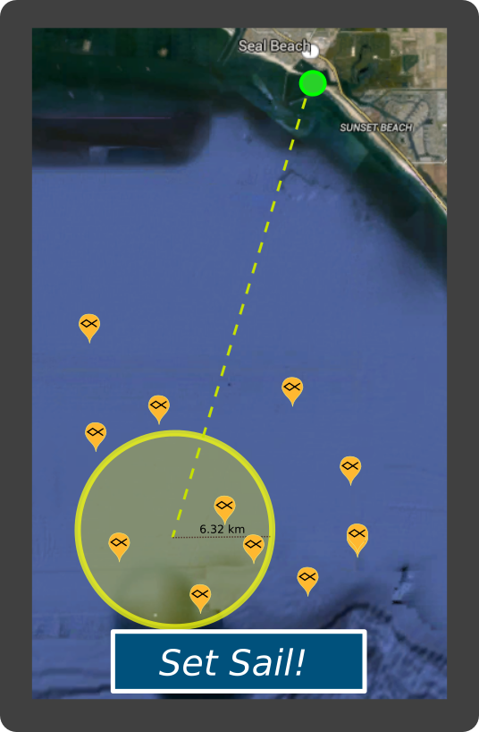
Our Vision of Social Appeal
Before heading out the user will look at the map for useful information such as weather and information publically submitted by other users.
After they choose a range for their destination while online the app will automatically download relevant information regarding fish known to be in that area.
REMINDER: Don’t forget your gear! (including the fiduciary!)

Slide 5
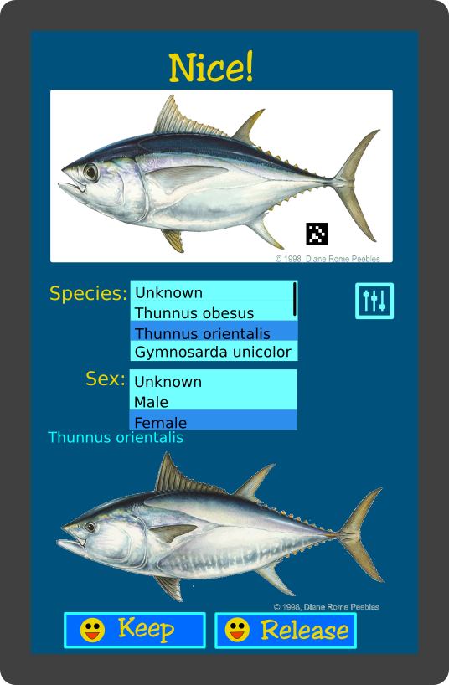
Identifying The Catch
App algorithm lists best matches from preloaded location data.
Sorting options help the user navigate the list.
Instant gratification for their submission with Gamification features on the app.
Sharing location on the website will optional, but scientists will still get complete geotagged and timestamped information for study.

Slide 6
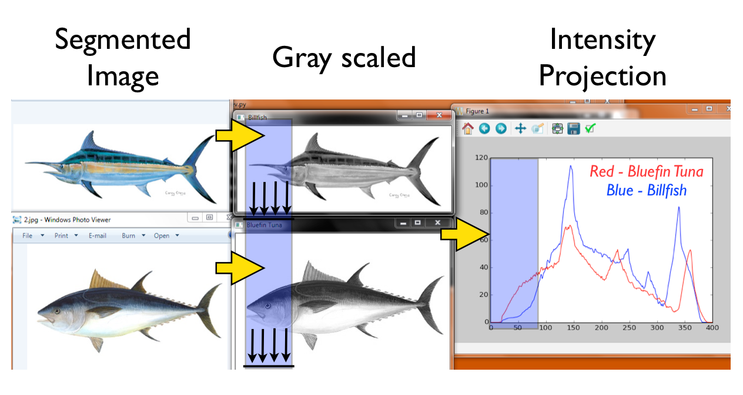

Slide 7
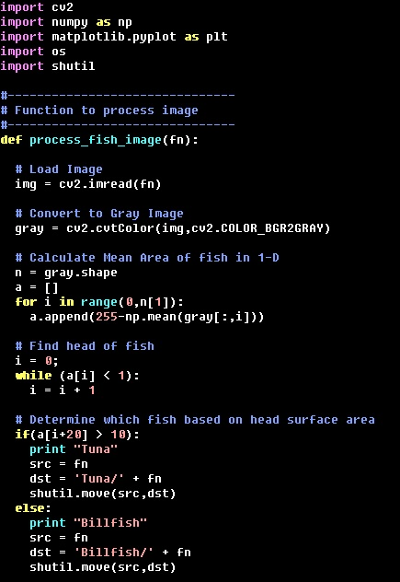

Slide 8
Red Right Returning!
When User is within range of a signal, the app will sync their new submissions to the server.
Other users can flag questionable species ID’s of the fish. Machine learning algorithms on the server can further flag questionable ID’s. Scientists can moderate and verify.
Comments, Tips/Advice, and Eco-News can be viewed/shared on the website after a hard day at sea.
Events and Achievements can be organized by scientists to encourage and study the effects of eco-friendly social fishing.

